Slide 1



Company Presentation
BEINIT ENERGY GROUP SERVICES LLC FZ
1

Slide 2
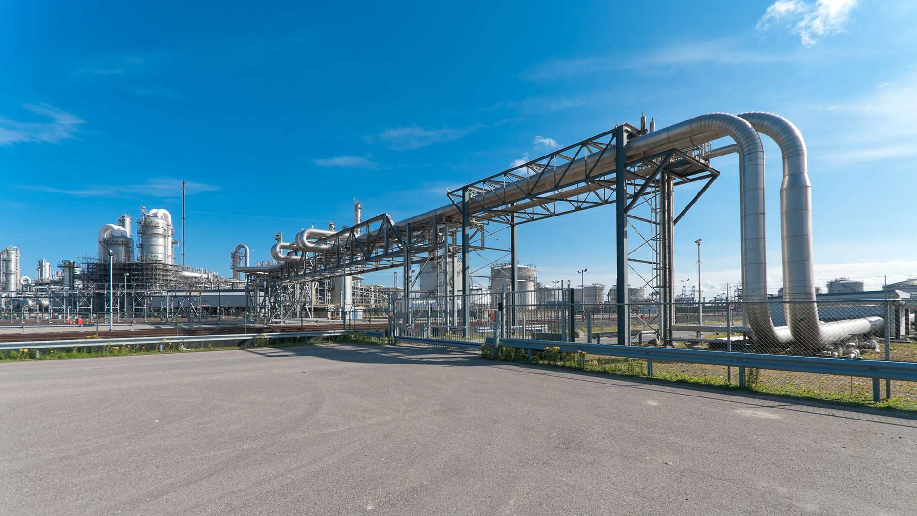
Who We Are
BEINIT Energy Group Services is an international energy consultancy, project and construction management company, founded and built on exceptional people, a commitment to service excellence and a deep-rooted entrepreneurial spirit.
Energy Services Specialists
We have three simple values that guide our behaviours and culture of innovation:
Safety First - everyone goes home safe and well.
Client Focused - Deliver on our promises.
Integrity - Always do the right thing.
These values permeate through everything we do, including our relationships with our clients, our partners, our suppliers and the communities where we work.

Slide 3

An International Oil & Gas Services Contractor
With comprehensive multi-discipline design and project management expertise, BEINIT Energy Group Service’s teams of highly skilled professionals provide innovative solutions to a variety of clients across 4 key markets:
•
•
•
•
Oil (Onshore & Offshore) Gas (Onshore & Offshore) Marine & Subsea Renewables
BEINIT Energy Group Services also has in-house specialist engineering capability encompassing geotechnical, technical safety, environmental, seismic and marine. Our technical teams are led by discipline-specific experts. We continually strive to develop smart solutions that enhance delivery efficiency and optimize constructibility to add value to our client’s bottom line.
Driven by Purpose, Fueled by Passion
Commitment to Our Clients
Technical Excellence stands as the foundation of our promise to apply the very highest standards in design, project management and stakeholder collaboration to realize the successful delivery of our projects.
At BEINIT Energy Group Services we understand that design and project management are vehicles to create real and lasting value for our clients. With that objective, we focus on understanding what value creation means to our clients and align our efforts accordingly to maximize impact of that goal.
While such primary drivers of safety, cost, quality and schedule remain key to our delivery, we look beyond these to understand the benefits our clients are seeking when undertaking large and complex projects; our priority then becomes a matter of reinforcing our commitment to ensuring our client’s vision is realized.
As a result of being an independent small company in a big industry, BEINIT Energy Group Services maintains great agility and responsiveness to our clients. This commitment is led by our executive team who remain unwaveringly hands on in all they do to support our clients in achieving their desired results.
We are committed to providing a quality service to all our clients and we work continuously to improve our delivery through in-house professional development, client interaction, teamwork and work process improvement.

Slide 4









Our Capabilities
Specialities
In-Stock Production Equipment
Fast-Track Project Execution
Technology Innovation
Modular Plug & Play Process Skids
Flare Gas Monetization Solutions
Marginal Field Development
Creative Contracting Structures
Engineering, Procurement & Construction (EPC)
Engineering, Procurement & Construction Management (EPCM)
Project Management Consulting (PMC)
Build, Own, Operate & Transfer (BOOT)
Lease Operate & Dry-Hire Agreements
Carbon Credit Offset Financing
(in partnership with )
Types of Projects
•
•
•
•
•
•
•
Early Production Facilities (EPF) Gas to Power Plants
FPSO / FSO MOPU
SPM (Calm Buoy) Produced Water Desalter Packages
•
•
•
•
•
•
•
Solar / Microgrids Biofuels Refinery Waste Conversion
Power Generation (Mobile/Plants) Asset Refurbishment
Pipelines - Survey, Repair/Replace Storage Tanks

Slide 5
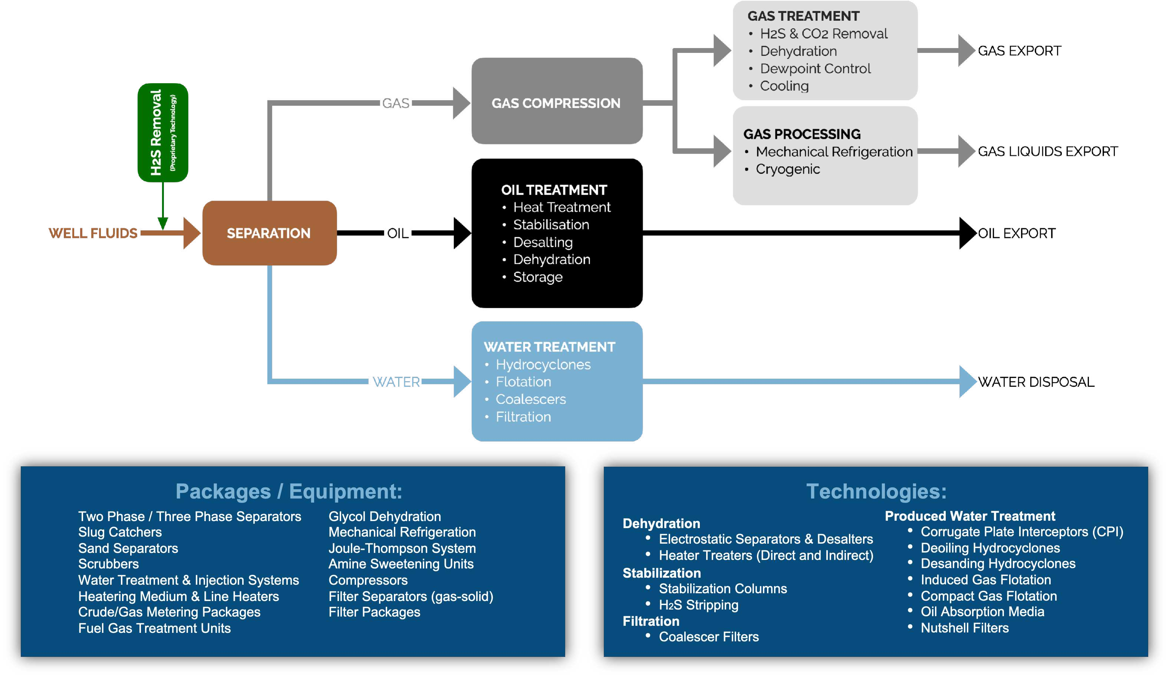
Upstream Separation & Processing (onshore / offshore)

Slide 6





Creating an Impact, Learning a Legacy BEINIT Energy Group Services and Affiliates
GLOBAL PROCESS SYSTEMS (GPS)
Interafcon DMCC
1992 - 2000
2016 - 2020
2024 - CURRENT
2000 - 2015
2020 - CURRENT
KVAERNER
BEINIT DMCC
BEINIT ENERGY Group Services LLC FZ

Slide 7
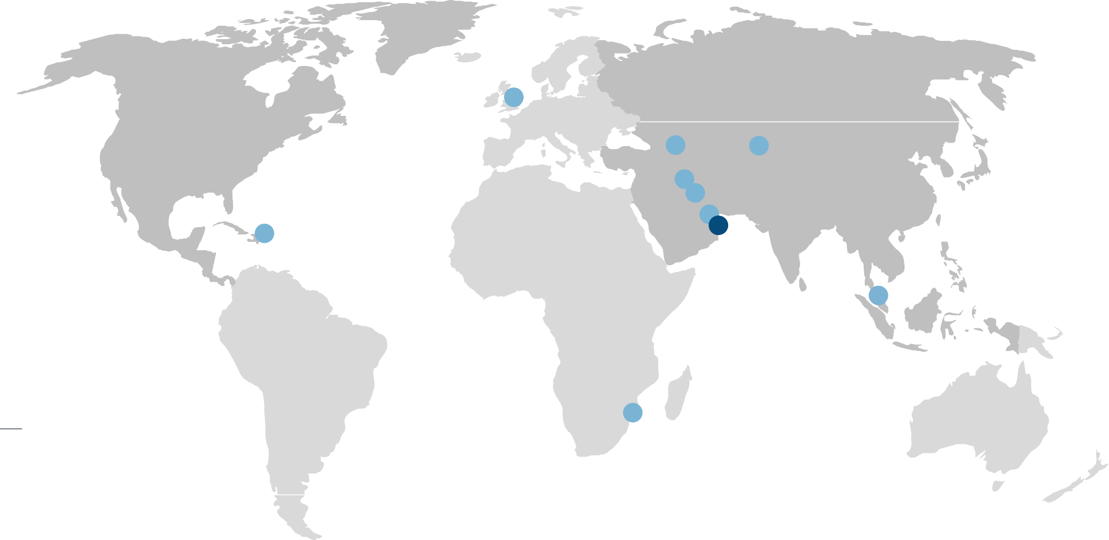
Global Presence - Building Success from the Ground Up
UK
Georgia
Tashkent
Erbil
Basra
Puerto Rico
Qatar
DUBAI
(Engineering Center)
Malaysia
(Engineering Center)
KEY
Mozambique
Head Office
Representative Office

Slide 8
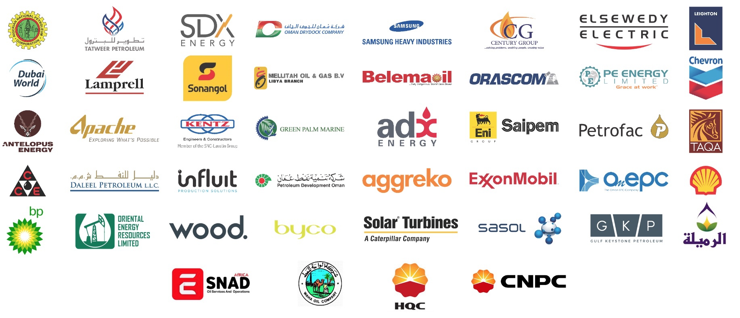
Global Clients

Slide 9
Thank You
for more information, please contact:
Steve Packer s.packer@beinitenergygroup.com
Joshua Smith j.smith@beinitenergygroup.com
51

